Slide 1
Company turnover prediction
Team Name : Anaconda
Done by: M. Nishma
B . Shravya
K . Harika Reddy
B . Sindhu
A .Sai Pranavi

Slide 2
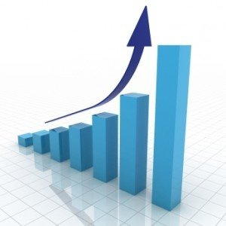
Introduction
• “TURNOVER OF A COMPANY” means to overall income & revenue of business in accounting period , which may be
quarterly, half and annual.
• Its may be in profit or loss, depends on their sales. If the sales reach their required level and fulfill the aim of company
so, its mean it is a positive effect but if sales not reach their required level and not fulfill the aim so its mean it is a
negative effect which mean loss.
• Every businessman have aim to make profit as possible within with fulfill the social responsibility.

Slide 3

COMPANY

Slide 4
TURNOVER
Advantages :
One of the primitive ratios used to measure a company’s performance is the sales generated.
Higher the sales better the company. but this may not give a true picture.
Disadvantages :
Turnover ratio does not measure how well a company is earning profits.
It only measures how well a company is generating sales. higher sales may or may not get translated to increase in profits.

Slide 5

Turnover

Slide 6
goal :
• This project proposes a novel method for the prediction of
COMPANY TURNOVER.
• Ability to predict the turnover accurately is crucial for company
to maximize their profits.
• Artificial neural networks have been successfully shown to gene-
rate high forecasting accuracy of company turnover point.

Slide 7
Artificial neural networks
Artificial neural networks (ANN) or connectionist systems are computing systems that are inspired by, but not necessarily identical to, the BIOLOGICAL NEURAL NETWORKS that constitute animal BRAINS.
An ANN is based on a collection of connected units or nodes called artificial neurons.
In common ANN implementations, the signal at a connection between artificial neurons is a real number, and the output of each artificial neuron is computed by some non-linear function of the sum of its inputs. The connections between artificial neurons are called 'edges’.
Ann consists of three layers:
Input layer
Hidden layer
Output layer

Slide 8
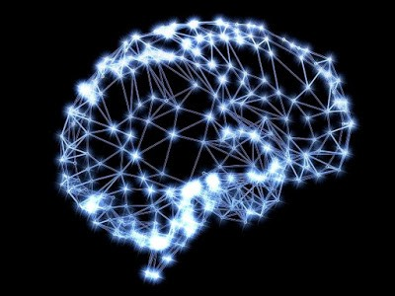

Slide 9
Input Layer: Input variables, sometimes called the
visible layer.
Hidden Layers: Layers of nodes between the input
and output layers. There may be one or more of
these layers.
Output Layer: A layer of nodes that produce the
output variables.

Slide 10
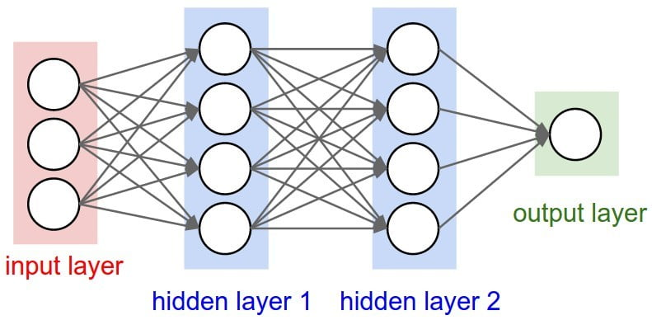

Slide 11
Data processing
• The data was downloaded from KAGGLE. It is pretty straight forward. Each row represents a company,
each column contains company attributes.
Date | Closing Price (0.01 NIS) | Change(%) | Opening Price | Base Price | High | Low | Capital Listed for Trading | Market Cap (NIS thousands) | Turnover (NIS) | Volume | Trans. | Index Adjusted No. of Shares (IANS) | Symbol
0 | 22-02-2018 | 17550.0 | 1.15 | 17440.0 | 17350.0 | 17580.0 | 17100.0 | 121272760 | 21283369 | 45119324 | 259345 | 1484 | 1.212728e+08 | AZRG
1 | 21-02-2018 | 17350.0 | 3.09 | 16830.0 | 16830.0 | 17610.0 | 16800.0 | 121272760 | 21040824 | 38974624 | 227319 | 1690 | 1.212728e+08 | AZRG
2 | 20-02-2018 | 16830.0 | 0.36 | 16720.0 | 16770.0 | 17000.0 | 16660.0 | 121272760 | 20410206 | 31823061 | 189453 | 702 | 1.212728e+08 | AZRG
3 | 19-02-2018 | 16770.0 | 2.51 | 16340.0 | 16360.0 | 16900.0 | 16340.0 | 121272760 | 20337442 | 16290735 | 97661 | 1107 | 1.212728e+08 | AZRG
4 | 18-02-2018 | 16360.0 | -1.09 | 16380.0 | 16540.0 | 16480.0 | 16200.0 | 121272760 | 19840224 | 12395932 | 75962 | 1001 | 1.212728e+08 | AZRG

Slide 12
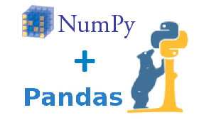
Importing libraries :
1.numpy:Numpy allows you to work with high-performance arrays and matrices.
2.pandas:allows you to work with datasets and data manipulations.

Slide 13
conclusion
Determining the turnover prediction is always been challenging work for company analysts.
Sales forecasting is very crucial for every company, especially for big ones.
This process is very complex because there are a lot of factors that should be taken into account.
In order to implement reachable goals and successfully achieve them, companies are keen on to predict next periods sales.
Compared to other methods, ANN’s are organic, and this method builds a learning algorithm to predict results better.

Slide 14


Slide 15


